Slide 1
Jelly Script

Slide 2
1. What is Jelly
Jelly is nothing but the Java Elements comprised of Java and XML-based scripting that originates from Apache Foundation.
ServiceNow uses Jelly Scripting to process XML-based documents containing static and dynamic HTML content and special Jelly Tags and the output is HTML.
Notes:
https://medium.com/@aakashgarg3108/introduction-to-servicenow-jelly-scripting-509a51c64147

Slide 3
1. What is Jelly
There are 2 kinds of tags in Jelly Scripting
Core Tags — known as Jelly Core.
Example:- <j:set>, <j:choose>, <j:if>, <j:forEach>, <j:otherwise>
ServiceNow Custom Tags — known as Glide Core.
Example:- <g:ui_form>, <g:evaluate>, <g:ui_reference>
However, you will find practical examples using both tags in this blog that help you to get started with Jelly Scripting. So, Stay Tuned!
Notes:
https://medium.com/@aakashgarg3108/introduction-to-servicenow-jelly-scripting-509a51c64147

Slide 4
2. Why learn Jelly?
ServiceNow uses Jelly Scripting a lot. There are 2 prominent places where ServiceNow uses Jelly Scripting.
UI Macros.
UI Pages.
UI Macros consist of Jelly Scripting only. However, we can induce Client Script in Jelly Script as well.
UI Pages consist of Jelly Script, Client Script, and Processing Script.
Notes:
https://medium.com/@aakashgarg3108/introduction-to-servicenow-jelly-scripting-509a51c64147

Slide 5
2. Why learn Jelly?
How to use it?
ServiceNow uses Formatters to place UI Macros (consisting of Jelly Scripting) in Forms.
To access or use UI Pages, There are 2 ways:-
Open UI Page directly using URI — https:<instance_name.service-now.com/<ui_page_name>.do
Open UI Page as a modal on the Client Side [using Client Script, UI Actions, etc.]
Notes:
https://medium.com/@aakashgarg3108/introduction-to-servicenow-jelly-scripting-509a51c64147

Slide 6
2. Why learn Jelly?
function confirmAction() { var dialog = new GlideDialogWindow('<ui_page_name>'); dialog.setTitle('My UI Page'); dialog.setSize(550, 200); // consists of Height and Width dialog.render(); } OR // This function helps you to open the UI Page in a new window. function confirmAction() { var features = "resizable=yes,scrollbars=yes,status=no,toolbar=no,menubar=yes,location=no,width=600,height=400"; var url = 'https://dev121229.service-now.com/sam_poc1.do?sysparm_stack=no&sysparm_id=' + g_form.getUniqueValue(); // Replace 'https://dev121229.service-now.com/sam_poc1.do' with your '<instance_name/ui_page.do>' g_navigation.open(url, "Printer_friendly_format", features); }
Notes:
https://medium.com/@aakashgarg3108/introduction-to-servicenow-jelly-scripting-509a51c64147

Slide 7
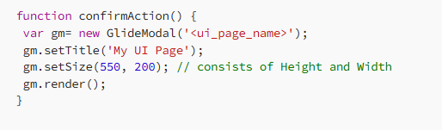
2. Why learn Jelly?
NOTE:- The GlideModal class is an alternative way of the GlideDialogWindow class to call UI Page. The syntax is:-
Notes:
https://medium.com/@aakashgarg3108/introduction-to-servicenow-jelly-scripting-509a51c64147

Slide 8
2. Why learn Jelly?
Query Parameters
In Query Parameters, an object known as RP has several methods like getParameterValue(), and getWindowProperties().get() that provide information about the page context in the UI Page.
Notes:
https://medium.com/@aakashgarg3108/introduction-to-servicenow-jelly-scripting-509a51c64147

Slide 9
2. Why learn Jelly?
You can use the setPreference() method of the GlideDialogWindow class to pass the query parameter from the Client Side to the UI Page
function confirmAction() { var dialog = new GlideDialogWindow('<ui_page_name>'); dialog.setTitle('My UI Page'); dialog.setPreference('sysparm_sysid', g_form.getUniqueValue()); // setPreference function used to pass the query parameters that can be used in UI Page. dialog.setSize(550, 200); dialog.render(); }
Notes:
https://medium.com/@aakashgarg3108/introduction-to-servicenow-jelly-scripting-509a51c64147

Slide 10
2. Why learn Jelly?
Access Query Parameters in UI Page
There are two ways to access query parameters:-
Use <g:evaluate> with RP.getParameterValue() or RP.getWindowProperties().get() to get query parameters from the client script
Use <j:set> to get query parameters
Notes:
https://medium.com/@aakashgarg3108/introduction-to-servicenow-jelly-scripting-509a51c64147

Slide 11
2. Why learn Jelly?
<g:evaluate var="sys_id"> var sys_id = RP.getParameterValue("sysparm_sysid"); sys_id; </g:evaluate> <h1>Hey, I got ${sys_id}.</h1> OR <g:evaluate var="jvar_sysid" expression="RP.getWindowProperties().get('sysparm_sysid')"> </g:evaluate> <div> <h1>Welcome, ${jvar_sysid}</h1> </div> <style> h1{ display:inline; } </style>
Notes:
https://medium.com/@aakashgarg3108/introduction-to-servicenow-jelly-scripting-509a51c64147

Slide 12
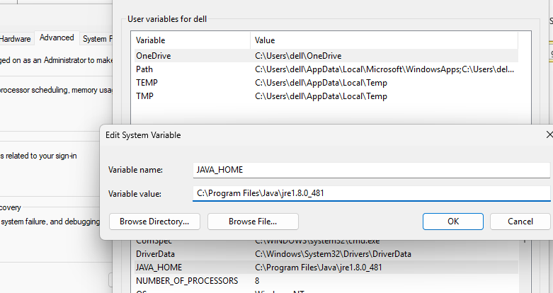
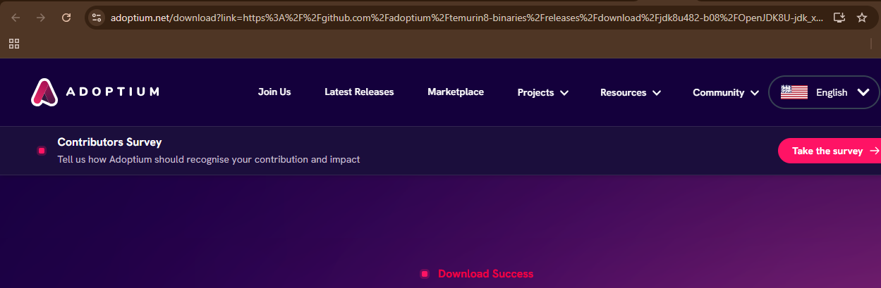
3. Install Jelly
First we need to install java from oracle
I will use java 8
https://www.java.com/en/download/manual.jsp
https://adoptium.net/temurin/releases/?version=8
Then in environment system variable we will add JAVA_HOME
Notes:
https://medium.com/@aakashgarg3108/introduction-to-servicenow-jelly-scripting-509a51c64147
https://commons.apache.org/proper/commons-jelly/

Slide 13
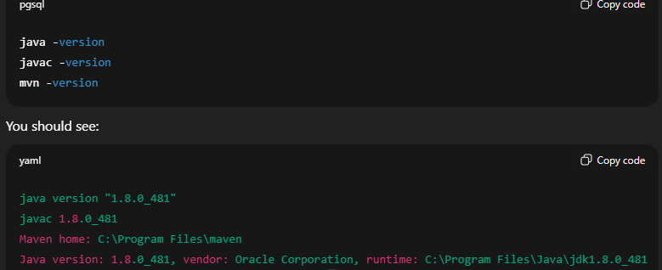
3. Install Jelly
First we need to install java from oracle
I will use java 8
https://www.java.com/en/download/manual.jsp
https://adoptium.net/temurin/releases/?version=8
Then in environment system variable we will add JAVA_HOME
Notes:
https://medium.com/@aakashgarg3108/introduction-to-servicenow-jelly-scripting-509a51c64147
https://commons.apache.org/proper/commons-jelly/

Slide 14
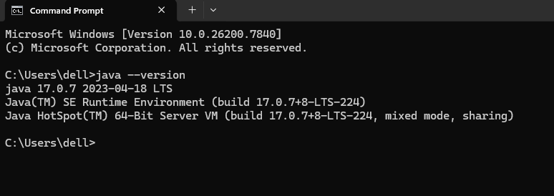
3. Install Jelly
To make sure that java is running
Open cmd and run java --version
Notes:
https://medium.com/@aakashgarg3108/introduction-to-servicenow-jelly-scripting-509a51c64147
https://commons.apache.org/proper/commons-jelly/

Slide 15
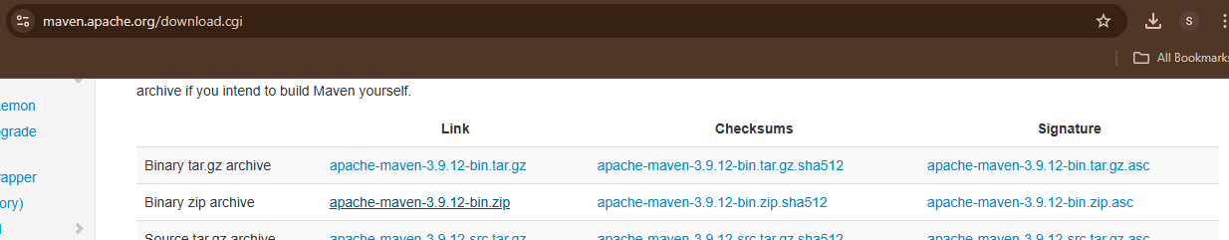
3. Install Jelly
Then we will download maven to can run any jelly script
https://maven.apache.org/download.cgi
Notes:
https://medium.com/@aakashgarg3108/introduction-to-servicenow-jelly-scripting-509a51c64147
https://commons.apache.org/proper/commons-jelly/

Slide 16
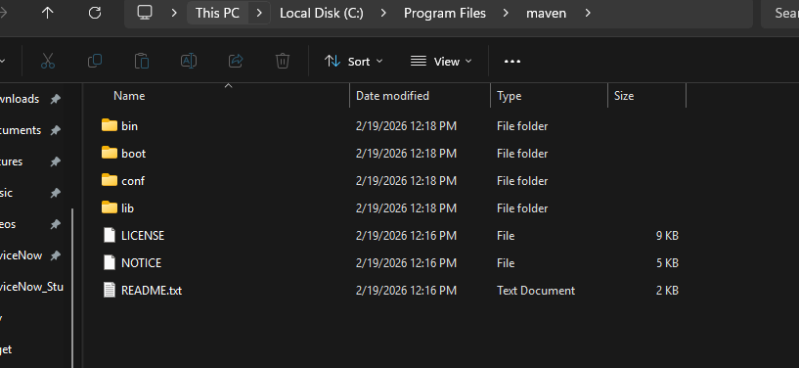
3. Install Jelly
Then create folder in C:\Program Files called maven and copy the extracted from zip
Add in enviroment system the path of maven to make run mvn command
Notes:
https://medium.com/@aakashgarg3108/introduction-to-servicenow-jelly-scripting-509a51c64147
https://commons.apache.org/proper/commons-jelly/

Slide 17
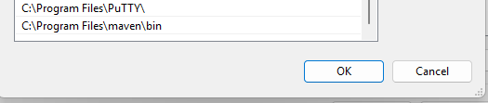
3. Install Jelly
Then create folder in C:\Program Files called maven and copy the extracted from zip
Add in enviroment system the path of maven to make run mvn command
Notes:
https://medium.com/@aakashgarg3108/introduction-to-servicenow-jelly-scripting-509a51c64147
https://commons.apache.org/proper/commons-jelly/

Slide 18
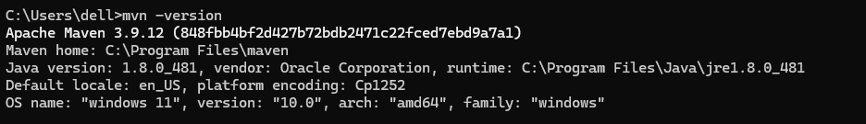
3. Install Jelly
To make sure that is maven is running open CMD
Mvn –version
Also that show the java is running in Maven
May be need to restart your PC to make sure everything is running
Notes:
https://medium.com/@aakashgarg3108/introduction-to-servicenow-jelly-scripting-509a51c64147
https://commons.apache.org/proper/commons-jelly/

Slide 19
3. POM FILE
In the context of JellyScript, a POM file usually refers to the same concept used in the Java ecosystem: a Project Object Model (POM) file used by Apache Maven.
What is a POM file?
A POM file is an XML file named:
It defines:
Project metadata (name, version, description)
Dependencies (external libraries your project needs)
Build configuration
Plugins
Packaging type
Repository information
Notes:
https://medium.com/@aakashgarg3108/introduction-to-servicenow-jelly-scripting-509a51c64147
https://commons.apache.org/proper/commons-jelly/

Slide 20
3. POM FILE
Why would JellyScript have a POM file?
If JellyScript:
Runs on the JVM, or
Integrates with Java libraries, or
Is built using Maven
then it may use a pom.xml file to manage dependencies and builds.
In Simple Terms
Think of a POM file as:
The configuration file that tells Maven how to build your project and what libraries it needs.
Notes:
https://medium.com/@aakashgarg3108/introduction-to-servicenow-jelly-scripting-509a51c64147
https://commons.apache.org/proper/commons-jelly/

Slide 21
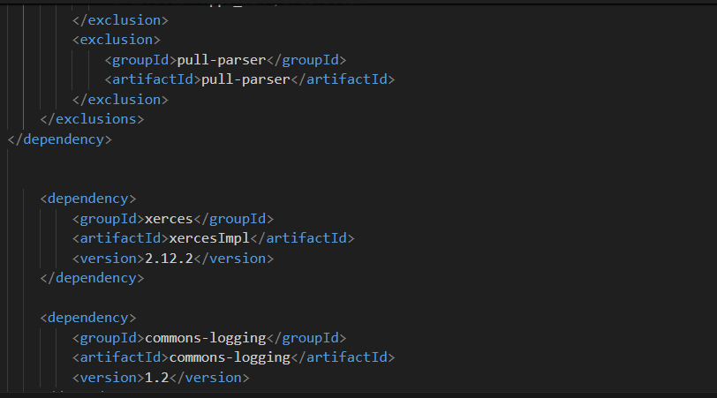
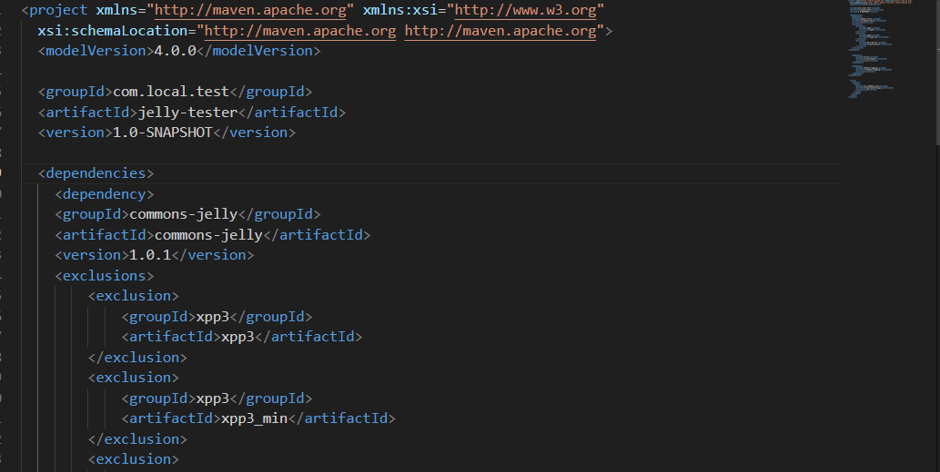
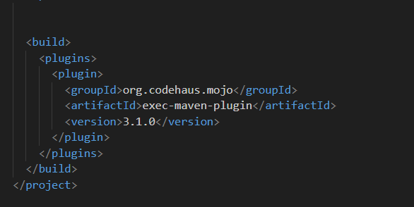
3. POM FILE
Notes:
https://medium.com/@aakashgarg3108/introduction-to-servicenow-jelly-scripting-509a51c64147
https://commons.apache.org/proper/commons-jelly/

Slide 22
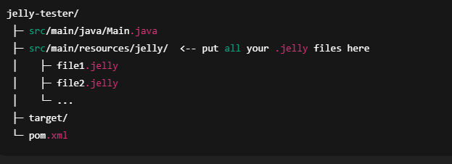
3. Install Jelly
To make build for all .jelly file
Create file Main.java
Notes:
https://medium.com/@aakashgarg3108/introduction-to-servicenow-jelly-scripting-509a51c64147
https://commons.apache.org/proper/commons-jelly/

Slide 23
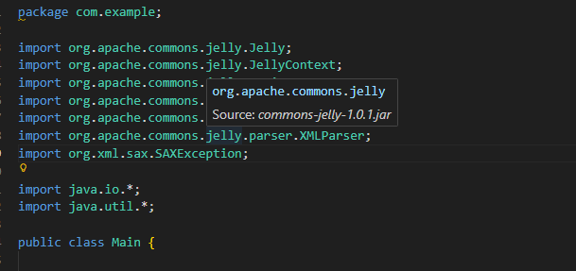
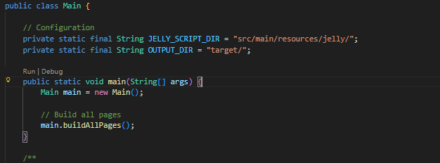
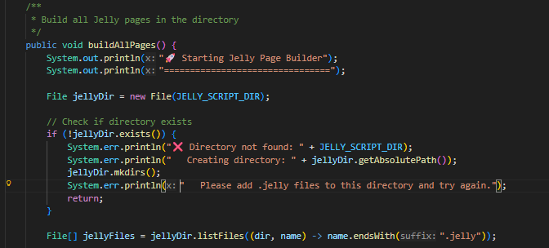
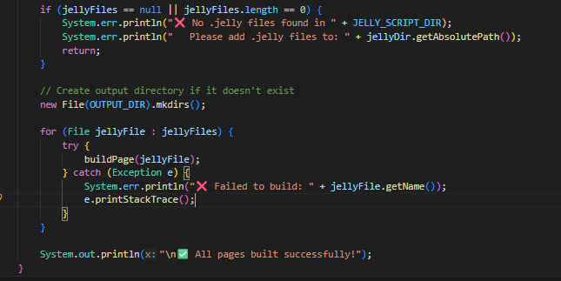
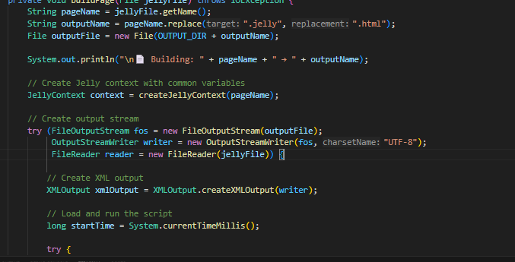
3. Install Jelly
Main.java File
Notes:
https://medium.com/@aakashgarg3108/introduction-to-servicenow-jelly-scripting-509a51c64147
https://commons.apache.org/proper/commons-jelly/

Slide 24
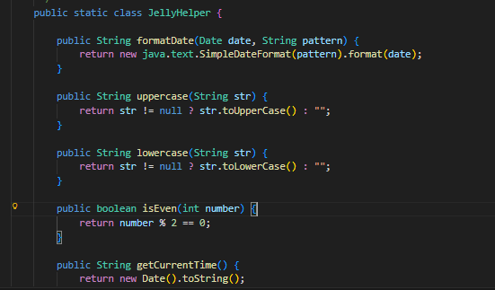
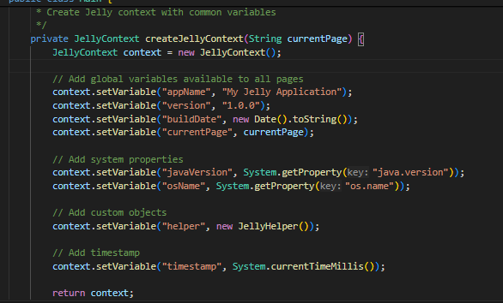
3. Install Jelly
Main.java File
Notes:
https://medium.com/@aakashgarg3108/introduction-to-servicenow-jelly-scripting-509a51c64147
https://commons.apache.org/proper/commons-jelly/

Slide 25
3. Install Jelly
Some Command may you will need it in mvn
Mvn clean
mvn exec:java -Dexec.mainClass=org.apache.commons.jelly.Jelly -Dexec.args=“your_script.jelly -o target/page.html“ to make it out as html file
mvn dependency:tree
mvn clean compile exec:java -Dexec.mainClass=org.apache.commons.jelly.Jelly -Dexec.args=“your_script.jelly -o page.html“
mvn clean compile exec:java "-Dexec.mainClass=Main“ → To build many files .jelly
Notes:
https://medium.com/@aakashgarg3108/introduction-to-servicenow-jelly-scripting-509a51c64147
https://commons.apache.org/proper/commons-jelly/

Slide 26
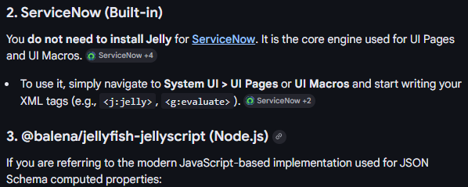
3. Install Jelly
npm install @balena/jellyfish-jellyscript
Notes:
https://medium.com/@aakashgarg3108/introduction-to-servicenow-jelly-scripting-509a51c64147
https://commons.apache.org/proper/commons-jelly/

Slide 27
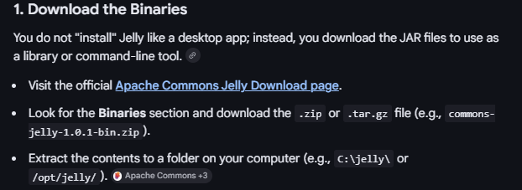
3. Install Jelly
https://commons.apache.org/jelly/download_jelly.cgi
Notes:
https://medium.com/@aakashgarg3108/introduction-to-servicenow-jelly-scripting-509a51c64147
https://commons.apache.org/proper/commons-jelly/

Slide 28
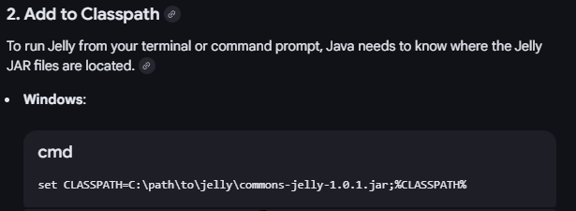
3. Install Jelly
https://commons.apache.org/jelly/download_jelly.cgi
set CLASSPATH=C:\path\to\jelly\commons-jelly-1.0.1.jar;%CLASSPATH%
Notes:
set CLASSPATH=C:\path\to\jelly\commons-jelly-1.0.1.jar;%CLASSPATH%

Slide 29
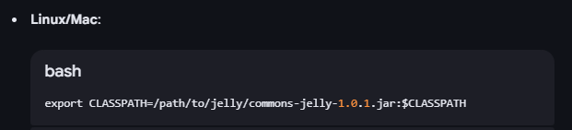
3. Install Jelly
https://commons.apache.org/jelly/download_jelly.cgi
export CLASSPATH=/path/to/jelly/commons-jelly-1.0.1.jar:$CLASSPATH
Notes:
https://medium.com/@aakashgarg3108/introduction-to-servicenow-jelly-scripting-509a51c64147
https://commons.apache.org/proper/commons-jelly/

Slide 30
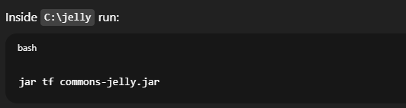
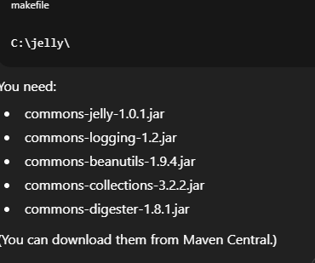
3. Install Jelly
https://commons.apache.org/jelly/download_jelly.cgi
jar tf commons-jelly.jar
https://maven.apache.org/download.cgi
Notes:
https://medium.com/@aakashgarg3108/introduction-to-servicenow-jelly-scripting-509a51c64147
https://commons.apache.org/proper/commons-jelly/

Slide 31
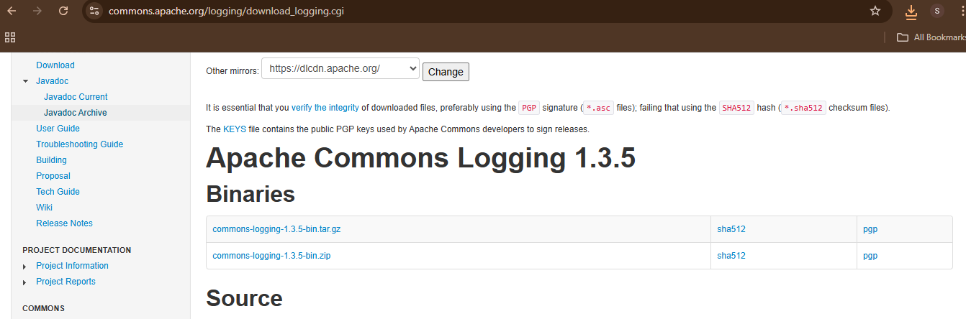
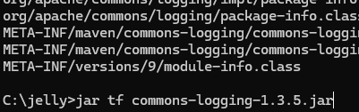
3. Install Jelly
https://commons.apache.org/logging/download_logging.cgi
jar tf commons-logging-1.3.5.jar
https://maven.apache.org/download.cgi
Notes:
https://commons.apache.org/logging/download_logging.cgi

Slide 32
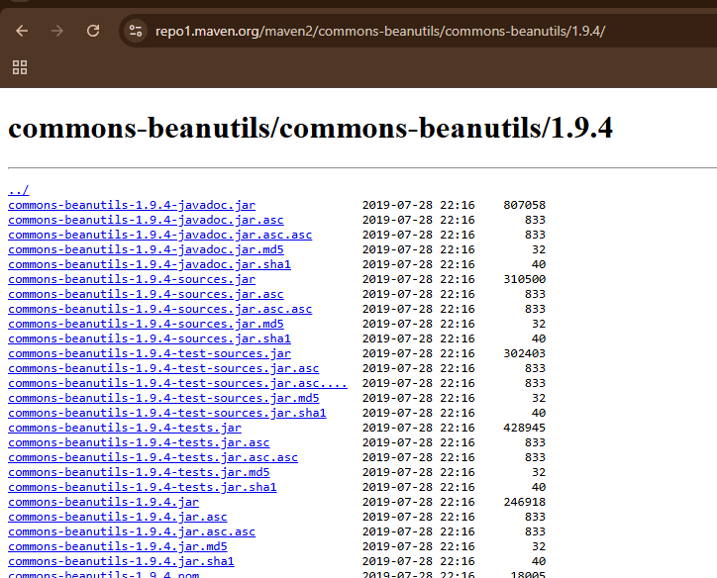
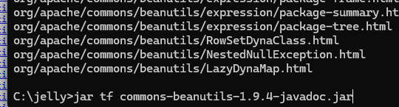
3. Install Jelly
https://repo1.maven.org/maven2/commons-beanutils/commons-beanutils/1.9.4/
jar tf commons-beanutils-1.9.4-javadoc.jar
https://maven.apache.org/download.cgi
Notes:
https://commons.apache.org/logging/download_logging.cgi

Slide 33
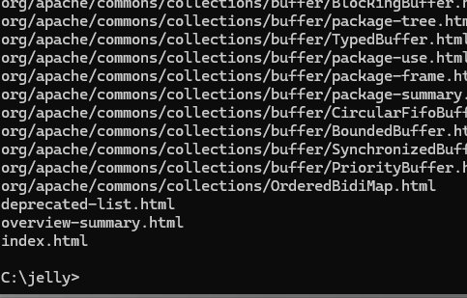
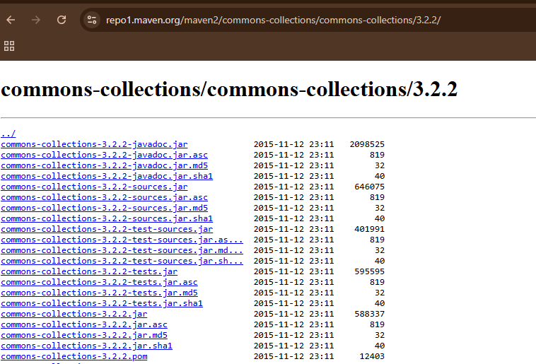
3. Install Jelly
https://repo1.maven.org/maven2/commons-collections/commons-collections/3.2.2/
jar tf commons-collections-3.2.2-javadoc.jar
https://maven.apache.org/download.cgi
Notes:
https://commons.apache.org/logging/download_logging.cgi

Slide 34
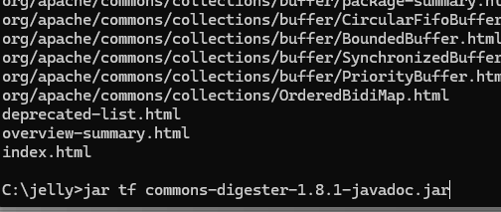
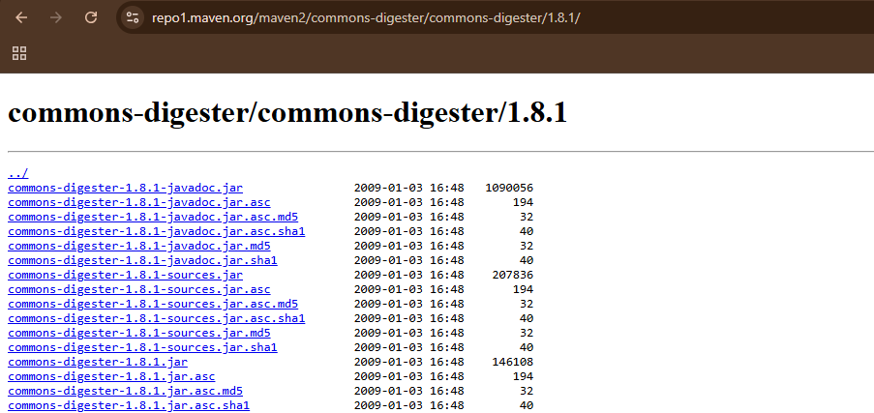
3. Install Jelly
https://repo1.maven.org/maven2/commons-digester/commons-digester/1.8.1/
jar tf commons-digester-1.8.1-javadoc.jar
https://maven.apache.org/download.cgi
Notes:
https://commons.apache.org/logging/download_logging.cgi

Slide 35
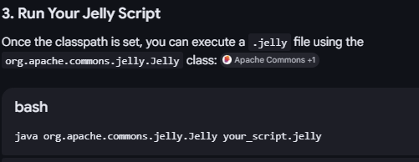
3. Install Jelly
https://commons.apache.org/jelly/download_jelly.cgi
java org.apache.commons.jelly.Jelly your_script.jelly
Notes:
https://medium.com/@aakashgarg3108/introduction-to-servicenow-jelly-scripting-509a51c64147
https://commons.apache.org/proper/commons-jelly/

Slide 36
3. Install Jelly
https://downloads.apache.org/commons/jelly/binaries/commons-jelly-1.0.1-bin.zip
java org.apache.commons.jelly.Jelly your_script.jelly
Notes:
https://medium.com/@aakashgarg3108/introduction-to-servicenow-jelly-scripting-509a51c64147
https://commons.apache.org/proper/commons-jelly/

Slide 37
2. Why learn Jelly?
<j:set var="jvar_sys_id" value="${sysparm_sysid}"> </j:set> <h1>${jvar_sys_id}</h1>
Notes:
https://medium.com/@aakashgarg3108/introduction-to-servicenow-jelly-scripting-509a51c64147

Slide 38
3. Tags
jelly:core : The core Tags from the JSTL plus Jelly extensions.
Tag | Purpose
choose | Conditional block to choose among multiple conditions. (commons.apache.org)
when | Used inside choose to test a condition. (commons.apache.org)
otherwise | Fallback inside choose if no when matches. (commons.apache.org)
if | Conditional evaluation of body when test is true. (commons.apache.org)
switch | Switch/Case control structure. (commons.apache.org)
case | A switch case. (commons.apache.org)
default | Default section of a switch. (commons.apache.org)
break | Breaks out of a loop. (commons.apache.org)
while | Loop while condition is true. (commons.apache.org)
forEach | Loop over items like arrays or lists. (commons.apache.org)
Notes:
https://medium.com/@aakashgarg3108/introduction-to-servicenow-jelly-scripting-509a51c64147
https://commons.apache.org/proper/commons-jelly/tags.html

Slide 39
3. Tags
Evaluation & Expression Tags
Tag | Purpose
expr | Evaluate an expression and output the result. (commons.apache.org)
getStatic | Get a static field value from a Java class. (commons.apache.org)
Notes:
https://medium.com/@aakashgarg3108/introduction-to-servicenow-jelly-scripting-509a51c64147
https://commons.apache.org/proper/commons-jelly/tags.html

Slide 40
3. Tags
Object & Context Tags
Tag | Purpose
new | Instantiate a new object. (commons.apache.org)
invoke | Call a method on an object. (commons.apache.org)
invokeStatic | Call a static method. (commons.apache.org)
useBean | Create & configure a Java bean. (commons.apache.org)
useList | Build a list from items. (commons.apache.org)
setProperties | Set properties on beans. (commons.apache.org)
Notes:
https://medium.com/@aakashgarg3108/introduction-to-servicenow-jelly-scripting-509a51c64147
https://commons.apache.org/proper/commons-jelly/tags.html

Slide 41
3. Tags
Variable & Scope Tags
Tag | Purpose
set | Assign a variable’s value. (commons.apache.org)
remove | Remove a variable from scope. (commons.apache.org)
scope | Create a nested variable scope. (commons.apache.org)
arg | Pass arguments to other tags like new or invoke. (commons.apache.org)
Notes:
https://medium.com/@aakashgarg3108/introduction-to-servicenow-jelly-scripting-509a51c64147
https://commons.apache.org/proper/commons-jelly/tags.html

Slide 42
3. Tags
Output & Script Control
Tag | Purpose
jelly | Root tag of a Jelly script. (commons.apache.org)
file | Write content to a file or variable. (commons.apache.org)
include | Include another script or file. (commons.apache.org)
import | Import another Jelly script. (commons.apache.org)
parse | Parse body text as Jelly and run it. (commons.apache.org)
mute | Execute body but don’t output results. (commons.apache.org)
thread | Run body in a new thread. (commons.apache.org)
whitespace | Preserve whitespace inside the body. (commons.apache.org)
Notes:
https://medium.com/@aakashgarg3108/introduction-to-servicenow-jelly-scripting-509a51c64147
https://commons.apache.org/proper/commons-jelly/tags.html

Slide 43
4.Start Write
Print Jello World.
The name “Jello World” is interesting. Right! Programmers can understand it more :)
<?xml version="1.0" encoding="utf-8" ?> <j:jelly trim="false" xmlns:j="jelly:core" xmlns:g="glide" xmlns:j2="null" xmlns:g2="null"> <h1>Jello World</h1> </j:jelly>
Notes:
https://medium.com/@aakashgarg3108/introduction-to-servicenow-jelly-scripting-509a51c64147

Slide 44
4.Start Write
Print Jello World.
The name “Jello World” is interesting. Right! Programmers can understand it more :)
<?xml version="1.0" encoding="utf-8" ?>
<jelly>
<html>
<body>
<h1>Hello World from Jelly!</h1>
<p>This page was generated locally.</p>
</body>
</html>
</jelly>
Notes:
https://medium.com/@aakashgarg3108/introduction-to-servicenow-jelly-scripting-509a51c64147

Slide 45
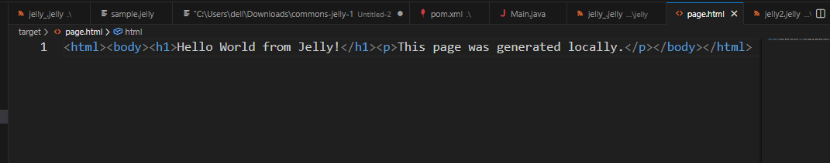
4.Start Write
To genenarte as html
mvn exec:java "-Dexec.mainClass=org.apache.commons.jelly.Jelly" "-Dexec.args=your_script.jelly -o target/page.html"
<?xml version="1.0" encoding="utf-8" ?>
<jelly>
<html>
<body>
<h1>Hello World from Jelly!</h1>
<p>This page was generated locally.</p>
</body>
</html>
</jelly>
Notes:
https://medium.com/@aakashgarg3108/introduction-to-servicenow-jelly-scripting-509a51c64147

Slide 46
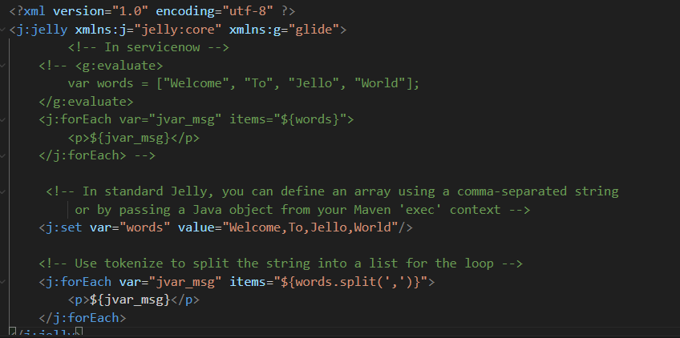
4.Start Write
2. Print an Array.
var words = ["Welcome", "To", "Jello", "World"]
<?xml version="1.0" encoding="utf-8" ?>
<j:jelly xmlns:j="jelly:core" xmlns:g="glide">
<!-- In servicenow -->
<!-- <g:evaluate>
var words = ["Welcome", "To", "Jello", "World"];
</g:evaluate>
<j:forEach var="jvar_msg" items="${words}">
<p>${jvar_msg}</p>
</j:forEach> -->
<!-- In standard Jelly, you can define an array using a comma-separated string
or by passing a Java object from your Maven 'exec' context -->
<j:set var="words" value="Welcome,To,Jello,World"/>
<!-- Use tokenize to split the string into a list for the loop -->
<j:forEach var="jvar_msg" items="${words.split(',')}">
<p>${jvar_msg}</p>
</j:forEach>
</j:jelly>
Notes:
https://medium.com/@aakashgarg3108/introduction-to-servicenow-jelly-scripting-509a51c64147

Slide 47

4.Start Write
2. Print an Array.
After generate to html
<?xml version="1.0" encoding="utf-8" ?>
<j:jelly xmlns:j="jelly:core" xmlns:g="glide">
<!-- In servicenow -->
<!-- <g:evaluate>
var words = ["Welcome", "To", "Jello", "World"];
</g:evaluate>
<j:forEach var="jvar_msg" items="${words}">
<p>${jvar_msg}</p>
</j:forEach> -->
<!-- In standard Jelly, you can define an array using a comma-separated string
or by passing a Java object from your Maven 'exec' context -->
<j:set var="words" value="Welcome,To,Jello,World"/>
<!-- Use tokenize to split the string into a list for the loop -->
<j:forEach var="jvar_msg" items="${words.split(',')}">
<p>${jvar_msg}</p>
</j:forEach>
</j:jelly>
Notes:
https://medium.com/@aakashgarg3108/introduction-to-servicenow-jelly-scripting-509a51c64147

Slide 48
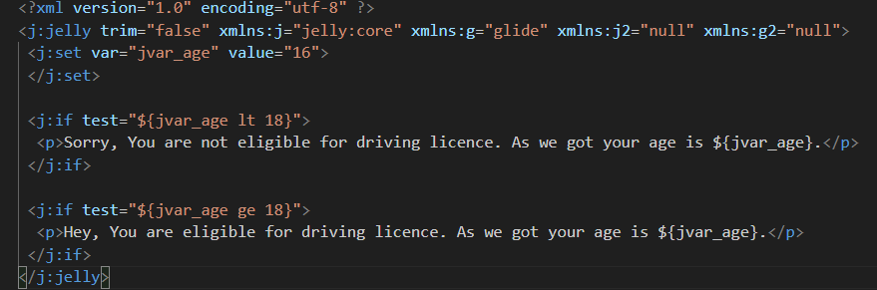
4.Start Write
2. Variable and with condition
After generate to html
<?xml version="1.0" encoding="utf-8" ?>
<j:jelly trim="false" xmlns:j="jelly:core" xmlns:g="glide" xmlns:j2="null" xmlns:g2="null">
<j:set var="jvar_age" value="16">
</j:set>
<j:if test="${jvar_age lt 18}">
<p>Sorry, You are not eligible for driving licence. As we got your age is ${jvar_age}.</p>
</j:if>
<j:if test="${jvar_age ge 18}">
<p>Hey, You are eligible for driving licence. As we got your age is ${jvar_age}.</p>
</j:if>
</j:jelly>
Notes:
https://medium.com/@aakashgarg3108/introduction-to-servicenow-jelly-scripting-509a51c64147

Slide 49
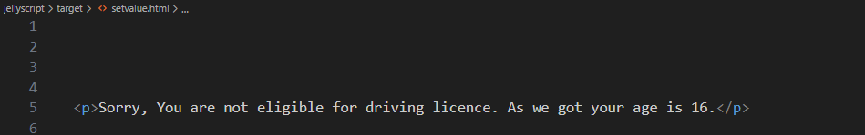
4.Start Write
2. Variable and with condition
After generate to html
Notes:
https://medium.com/@aakashgarg3108/introduction-to-servicenow-jelly-scripting-509a51c64147

Slide 50
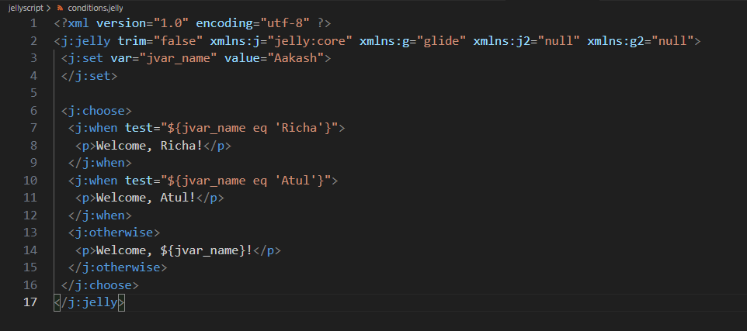
4.Start Write
2. Variable and with condition
After generate to html
<?xml version="1.0" encoding="utf-8" ?>
<j:jelly trim="false" xmlns:j="jelly:core" xmlns:g="glide" xmlns:j2="null" xmlns:g2="null">
<j:set var="jvar_name" value="Aakash">
</j:set>
<j:choose>
<j:when test="${jvar_name eq 'Richa'}">
<p>Welcome, Richa!</p>
</j:when>
<j:when test="${jvar_name eq 'Atul'}">
<p>Welcome, Atul!</p>
</j:when>
<j:otherwise>
<p>Welcome, ${jvar_name}!</p>
</j:otherwise>
</j:choose>
</j:jelly>
Notes:
https://medium.com/@aakashgarg3108/introduction-to-servicenow-jelly-scripting-509a51c64147

Slide 51
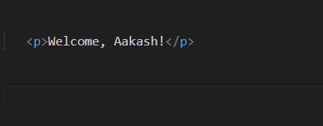
4.Start Write
2. Variable and with condition
After generate to html
Notes:
https://medium.com/@aakashgarg3108/introduction-to-servicenow-jelly-scripting-509a51c64147

Slide 52
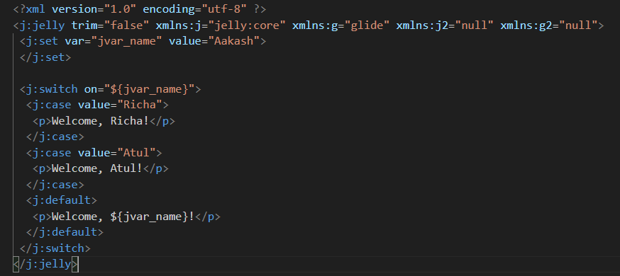
4.Start Write
2. Switch/case.
After generate to html
<?xml version="1.0" encoding="utf-8" ?>
<j:jelly trim="false" xmlns:j="jelly:core" xmlns:g="glide" xmlns:j2="null" xmlns:g2="null">
<j:set var="jvar_name" value="Aakash">
</j:set>
<j:switch on="${jvar_name}">
<j:case value="Richa">
<p>Welcome, Richa!</p>
</j:case>
<j:case value="Atul">
<p>Welcome, Atul!</p>
</j:case>
<j:default>
<p>Welcome, ${jvar_name}!</p>
</j:default>
</j:switch>
</j:jelly>
Notes:
https://medium.com/@aakashgarg3108/introduction-to-servicenow-jelly-scripting-509a51c64147

Slide 53
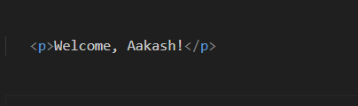
4.Start Write
2. Switch/case.
After generate to html
Notes:
https://medium.com/@aakashgarg3108/introduction-to-servicenow-jelly-scripting-509a51c64147

Slide 54
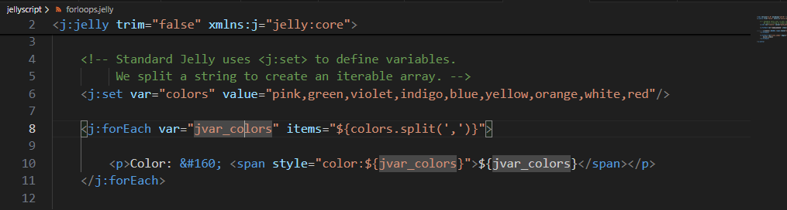
4.Start Write
<?xml version="1.0" encoding="utf-8" ?>
<j:jelly trim="false" xmlns:j="jelly:core">
<!-- Standard Jelly uses <j:set> to define variables.
We split a string to create an iterable array. -->
<j:set var="colors" value="pink,green,violet,indigo,blue,yellow,orange,white,red"/>
<j:forEach var="jvar_colors" items="${colors.split(',')}">
<p>Color: &#160; <span style="color:${jvar_colors}">${jvar_colors}</span></p>
</j:forEach>
<j:forEach var="jvar_index" begin="0" end="20" step="2">
${jvar_index}
</j:forEach>
</j:jelly>
2. Loops
After generate to html
Notes:
https://medium.com/@aakashgarg3108/introduction-to-servicenow-jelly-scripting-509a51c64147

Slide 55
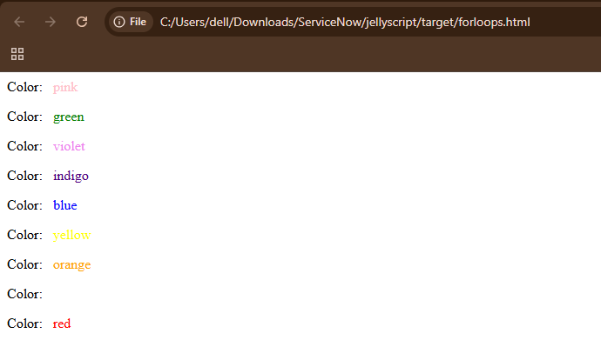
4.Start Write
<?xml version="1.0" encoding="utf-8" ?>
<j:jelly trim="false" xmlns:j="jelly:core">
<!-- Standard Jelly uses <j:set> to define variables.
We split a string to create an iterable array. -->
<j:set var="colors" value="pink,green,violet,indigo,blue,yellow,orange,white,red"/>
<j:forEach var="jvar_colors" items="${colors.split(',')}">
<p>Color: &#160; <span style="color:${jvar_colors}">${jvar_colors}</span></p>
</j:forEach>
<j:forEach var="jvar_index" begin="0" end="20" step="2">
${jvar_index}
</j:forEach>
</j:jelly>
2. Loops
After generate to html
Notes:
https://medium.com/@aakashgarg3108/introduction-to-servicenow-jelly-scripting-509a51c64147

Slide 56
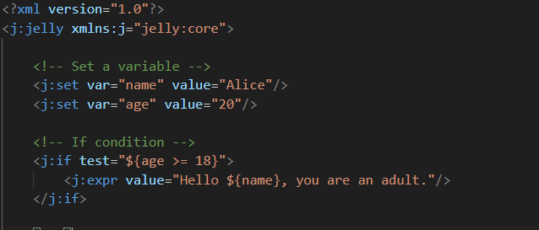
4.Start Write
<?xml version="1.0"?>
<j:jelly xmlns:j="jelly:core">
<!-- Set a variable -->
<j:set var="name" value="Alice"/>
<j:set var="age" value="20"/>
<!-- If condition -->
<j:if test="${age >= 18}">
<j:expr value="Hello ${name}, you are an adult."/>
</j:if>
<br/>
Notes:
https://medium.com/@aakashgarg3108/introduction-to-servicenow-jelly-scripting-509a51c64147
https://commons.apache.org/proper/commons-jelly/tags.html

Slide 57
4.Start Write
<?xml version="1.0"?>
<j:jelly xmlns:j="jelly:core">
<!-- Set a variable -->
<j:set var="name" value="Alice"/>
<j:set var="age" value="20"/>
<!-- If condition -->
<j:if test="${age >= 18}">
<j:expr value="Hello ${name}, you are an adult."/>
</j:if>
<br/>
Notes:
https://medium.com/@aakashgarg3108/introduction-to-servicenow-jelly-scripting-509a51c64147
https://commons.apache.org/proper/commons-jelly/tags.html

Slide 58
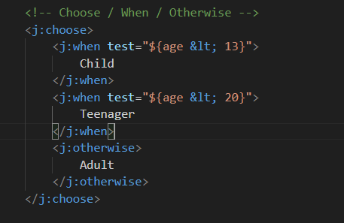

4.Start Write
<!-- Choose / When / Otherwise -->
<j:choose>
<j:when test="${age &lt; 13}">
Child
</j:when>
<j:when test="${age &lt; 20}">
Teenager
</j:when>
<j:otherwise>
Adult
</j:otherwise>
</j:choose>
Notes:
https://medium.com/@aakashgarg3108/introduction-to-servicenow-jelly-scripting-509a51c64147
https://commons.apache.org/proper/commons-jelly/tags.html

Slide 59
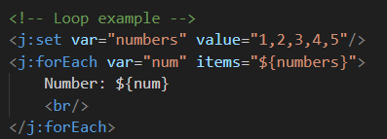
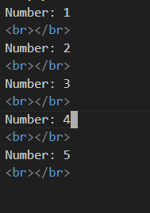
4.Start Write
<!-- Loop example -->
<j:set var="numbers" value="1,2,3,4,5"/>
<j:forEach var="num" items="${numbers}">
Number: ${num}
<br/>
</j:forEach>
Notes:
https://medium.com/@aakashgarg3108/introduction-to-servicenow-jelly-scripting-509a51c64147
https://commons.apache.org/proper/commons-jelly/tags.html

Slide 60
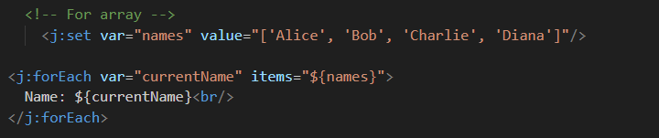

4.Start Write
<!-- For array -->
<j:set var="names" value="['Alice', 'Bob', 'Charlie', 'Diana']"/>
<j:forEach var="currentName" items="${names}">
Name: ${currentName}<br/>
</j:forEach>
Notes:
https://medium.com/@aakashgarg3108/introduction-to-servicenow-jelly-scripting-509a51c64147
https://commons.apache.org/proper/commons-jelly/tags.html

Slide 61


4.Start Write
<!-- Create Java ArrayList -->
<j:new className="java.util.ArrayList" var="names"/>
<j:invoke on="${names}" method="add">
<j:arg value="Alice"/>
</j:invoke>
<j:invoke on="${names}" method="add">
<j:arg value="Bob"/>
</j:invoke>
<j:invoke on="${names}" method="add">
<j:arg value="Charlie"/>
</j:invoke>
<j:invoke on="${names}" method="add">
<j:arg value="Diana"/>
</j:invoke>
<!-- Loop through it -->
<j:forEach var="currentName" items="${names}">
Name: ${currentName}<br/>
</j:forEach>
Notes:
https://medium.com/@aakashgarg3108/introduction-to-servicenow-jelly-scripting-509a51c64147
https://commons.apache.org/proper/commons-jelly/tags.html

Slide 62
4.Start Write
<j:new> creates a new Java object instance
className="java.util.ArrayList" specifies we want to create an ArrayList (a Java collection that can hold multiple items)
var="names" stores this new ArrayList in a variable called names
This is like doing ArrayList names = new ArrayList(); in Java
Let's break down the first <j:invoke>:
<j:invoke> calls a method on an existing Java object
on="${names}" specifies which object to call the method on (our ArrayList)
method="add" specifies we want to call the add() method
Inside, <j:arg value="Alice"/> provides the argument/parameter for the method
This is like doing names.add("Alice"); in Java
Notes:
https://medium.com/@aakashgarg3108/introduction-to-servicenow-jelly-scripting-509a51c64147
https://commons.apache.org/proper/commons-jelly/tags.html

Slide 63

4.Start Write
<!-- Parse String -->
<j:set var="nameString" value="Alice,Bob,Charlie,Diana"/>
<j:set var="names" value="${nameString.split(',')}"/>
<j:forEach var="currentName" items="${names}">
Name: ${currentName}<br/>
</j:forEach>
Notes:
https://medium.com/@aakashgarg3108/introduction-to-servicenow-jelly-scripting-509a51c64147
https://commons.apache.org/proper/commons-jelly/tags.html

Slide 64


4.Start Write
<!-- Create a Date object (current date/time) -->
<j:new className="java.util.Date" var="now"/>
Current date/time: ${now}<br/>
<!-- Get timestamp in milliseconds -->
<j:invoke on="${now}" method="getTime" var="timestamp"/>
Timestamp: ${timestamp} milliseconds<br/>
<!-- Format the date -->
<j:new className="java.text.SimpleDateFormat" var="formatter">
<j:arg value="yyyy-MM-dd HH:mm:ss"/>
</j:new>
<j:invoke on="${formatter}" method="format" var="formattedDate">
<j:arg value="${now}"/>
</j:invoke>
Formatted date: ${formattedDate}
Notes:
https://medium.com/@aakashgarg3108/introduction-to-servicenow-jelly-scripting-509a51c64147
https://commons.apache.org/proper/commons-jelly/tags.html

Slide 65

4.Start Write
Task:
Create custom date not taken today
Notes:
https://medium.com/@aakashgarg3108/introduction-to-servicenow-jelly-scripting-509a51c64147
https://commons.apache.org/proper/commons-jelly/tags.html

Slide 66


4.Start Write
<!-- Get static fields -->
<j:getStatic var="pi" className="java.lang.Math" field="PI"/>
<j:getStatic var="e" className="java.lang.Math" field="E"/>
PI value: ${pi}<br/>
E value: ${e}<br/>
Notes:
https://medium.com/@aakashgarg3108/introduction-to-servicenow-jelly-scripting-509a51c64147
https://commons.apache.org/proper/commons-jelly/tags.html

Slide 67

4.Start Write
Task:
Try to get random number but integer
Notes:
https://medium.com/@aakashgarg3108/introduction-to-servicenow-jelly-scripting-509a51c64147
https://commons.apache.org/proper/commons-jelly/tags.html

Slide 68

4.Start Write
<j:invokeStatic var="maxValue" className="java.lang.Math" method="max">
<j:arg value="10" type="int"/> <!-- Specify the type -->
<j:arg value="20" type="int"/>
</j:invokeStatic>
Max of 10 and 20: ${maxValue}<br/>
Notes:
https://medium.com/@aakashgarg3108/introduction-to-servicenow-jelly-scripting-509a51c64147
https://commons.apache.org/proper/commons-jelly/tags.html

Slide 69
4.Start Write
Task
Try To get Min
Notes:
https://medium.com/@aakashgarg3108/introduction-to-servicenow-jelly-scripting-509a51c64147
https://commons.apache.org/proper/commons-jelly/tags.html

Slide 70


4.Start Write
<j:invokeStatic var="rounded" className="java.lang.Math" method="round">
<j:arg value="3.14159" type="float"/>
</j:invokeStatic>
Rounded PI: ${rounded}
Notes:
https://medium.com/@aakashgarg3108/introduction-to-servicenow-jelly-scripting-509a51c64147
https://commons.apache.org/proper/commons-jelly/tags.html

Slide 71


4.Start Write
<!-- Create StringBuilder -->
<j:new className="java.lang.StringBuilder" var="builder"/>
<!-- Append strings -->
<j:invoke on="${builder}" method="append">
<j:arg value="Hello"/>
</j:invoke>
<j:invoke on="${builder}" method="append">
<j:arg value=" "/>
</j:invoke>
<j:invoke on="${builder}" method="append">
<j:arg value="World"/>
</j:invoke>
<!-- Get the final string -->
<j:invoke on="${builder}" method="toString" var="message"/>
Message: ${message}<br/>
<!-- Get length -->
<j:invoke on="${builder}" method="length" var="length"/>
Length: ${length}<br/>
<!-- Reverse it -->
<j:invoke on="${builder}" method="reverse"/>
Reversed: ${builder.toString()}
StringBuilder
Notes:
https://medium.com/@aakashgarg3108/introduction-to-servicenow-jelly-scripting-509a51c64147
https://commons.apache.org/proper/commons-jelly/tags.html

Slide 72

4.Start Write
StringBuilder
Notes:
https://medium.com/@aakashgarg3108/introduction-to-servicenow-jelly-scripting-509a51c64147
https://commons.apache.org/proper/commons-jelly/tags.html

Slide 73
3. Tags
Working with java.io.File
Notes:
https://medium.com/@aakashgarg3108/introduction-to-servicenow-jelly-scripting-509a51c64147
https://commons.apache.org/proper/commons-jelly/tags.html

Slide 74



4.Start Write
<!-- Create HashMap -->
<j:new className="java.util.HashMap" var="user"/>
<!-- Put key-value pairs -->
<j:invoke on="${user}" method="put">
<j:arg value="name"/>
<j:arg value="John Doe"/>
</j:invoke>
<j:invoke on="${user}" method="put">
<j:arg value="age"/>
<j:arg value="30"/>
</j:invoke>
<j:invoke on="${user}" method="put">
<j:arg value="city"/>
<j:arg value="New York"/>
</j:invoke>
<!-- Get values -->
<j:invoke on="${user}" method="get" var="userName">
<j:arg value="name"/>
</j:invoke>
<j:invoke on="${user}" method="get" var="userAge">
<j:arg value="age"/>
</j:invoke>
Name: ${userName}<br/>
Age: ${userAge}<br/>
<!-- Loop through entries -->
<j:invoke on="${user}" method="entrySet" var="entries"/>
<j:forEach var="entry" items="${entries}">
<j:invoke on="${entry}" method="getKey" var="key"/>
<j:invoke on="${entry}" method="getValue" var="value"/>
${key} = ${value}<br/>
</j:forEach>
Working with HashMap
Notes:
https://medium.com/@aakashgarg3108/introduction-to-servicenow-jelly-scripting-509a51c64147
https://commons.apache.org/proper/commons-jelly/tags.html

Slide 75

4.Start Write
Working with HashMap
Notes:
https://medium.com/@aakashgarg3108/introduction-to-servicenow-jelly-scripting-509a51c64147
https://commons.apache.org/proper/commons-jelly/tags.html

Slide 76

4.Start Write
Working with java.awt.Color
<j:getStatic var="red" className="java.awt.Color" field="RED"/>
<j:getStatic var="green" className="java.awt.Color" field="GREEN"/>
<j:getStatic var="blue" className="java.awt.Color" field="BLUE"/>
<!-- Method 2: Creating custom colors -->
<j:new className="java.awt.Color" var="purple">
<j:arg value="128" type="int"/>
<j:arg value="0" type="int"/>
<j:arg value="128" type="int"/>
</j:new>
Notes:
https://medium.com/@aakashgarg3108/introduction-to-servicenow-jelly-scripting-509a51c64147
https://commons.apache.org/proper/commons-jelly/tags.html

Slide 77
4.Start Write
Working with java.awt.Color
<j:getStatic var="red" className="java.awt.Color" field="RED"/>
<j:getStatic var="green" className="java.awt.Color" field="GREEN"/>
<j:getStatic var="blue" className="java.awt.Color" field="BLUE"/>
<!-- Method 2: Creating custom colors -->
<j:new className="java.awt.Color" var="purple">
<j:arg value="128" type="int"/>
<j:arg value="0" type="int"/>
<j:arg value="128" type="int"/>
</j:new>
Notes:
https://medium.com/@aakashgarg3108/introduction-to-servicenow-jelly-scripting-509a51c64147
https://commons.apache.org/proper/commons-jelly/tags.html

Slide 78

4.Start Write
Working with java.awt.Color
<j:new className="java.awt.Color" var="teal">
<j:arg value="0" type="int"/>
<j:arg value="128" type="int"/>
<j:arg value="128" type="int"/>
</j:new>
<!-- Method 3: With alpha -->
<j:new className="java.awt.Color" var="transparentRed">
<j:arg value="255" type="int"/>
<j:arg value="0" type="int"/>
<j:arg value="0" type="int"/>
<j:arg value="100" type="int"/> <!-- 100/255 transparency -->
</j:new>
Notes:
https://medium.com/@aakashgarg3108/introduction-to-servicenow-jelly-scripting-509a51c64147
https://commons.apache.org/proper/commons-jelly/tags.html

Slide 79


4.Start Write
<!-- Get RGB components -->
<j:invoke on="${purple}" method="getRed" var="r"/>
<j:invoke on="${purple}" method="getGreen" var="g"/>
<j:invoke on="${purple}" method="getBlue" var="b"/>
<!-- Display results -->
<h3>Colors:</h3>
Red (static): ${red}<br/>
Green (static): ${green}<br/>
Blue (static): ${blue}<br/>
Purple (custom): R=${r}, G=${g}, B=${b}<br/>
<!-- Get RGB integer value -->
<j:invoke on="${teal}" method="getRGB" var="rgb"/>
Teal RGB value: ${rgb}<br/>
<!-- Check if colors are equal -->
<j:invoke on="${red}" method="equals" var="isEqual">
<j:arg value="${red}"/>
</j:invoke>
Red equals itself: ${isEqual}
Working with java.awt.Color
Notes:
https://medium.com/@aakashgarg3108/introduction-to-servicenow-jelly-scripting-509a51c64147
https://commons.apache.org/proper/commons-jelly/tags.html

Slide 80
4.Start Write
Task
Try to set style based on color that already added
Notes:
https://medium.com/@aakashgarg3108/introduction-to-servicenow-jelly-scripting-509a51c64147
https://commons.apache.org/proper/commons-jelly/tags.html

Slide 81


3. Tags
Key Patterns to Remember
Notes:
https://medium.com/@aakashgarg3108/introduction-to-servicenow-jelly-scripting-509a51c64147
https://commons.apache.org/proper/commons-jelly/tags.html

